Slide 1
Mechanical Sensors: Piezoelectric Pressure Sensors IR and Ultrasonic Motion Sensors

Slide 2
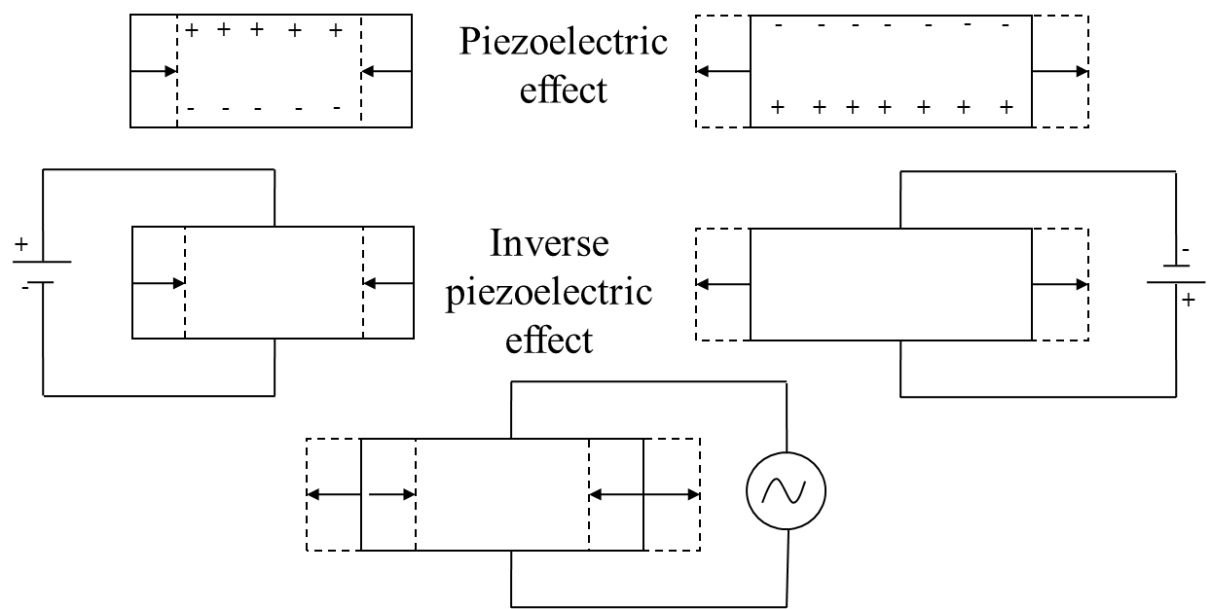

Piezoelectric and Inverse Piezoelectric Effect
$$f=\frac{1}{2d}\sqrt{\frac{Y}{ρ}}$$

Slide 3
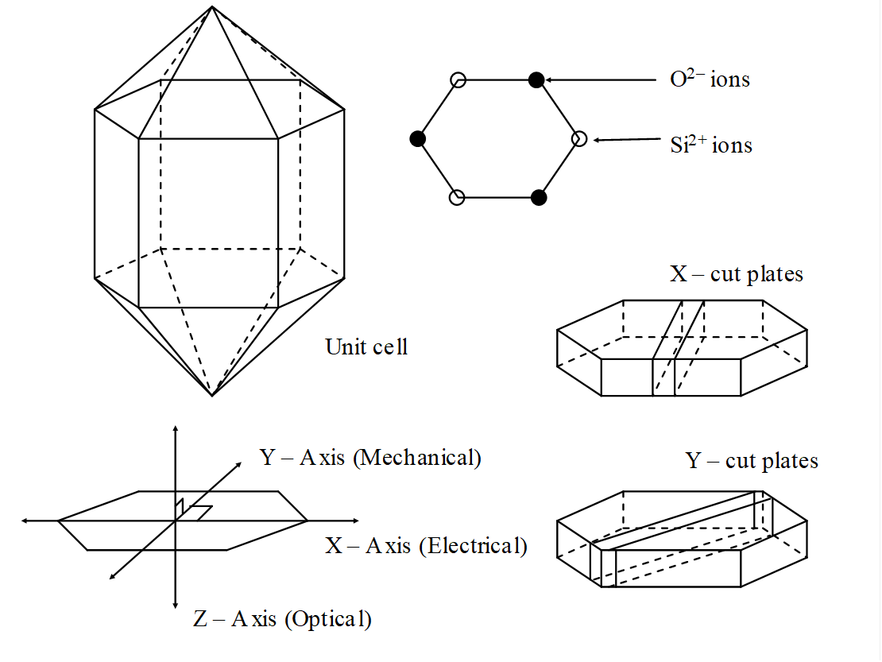
Quartz Crystal Axis and Crystal-cuts

Slide 4
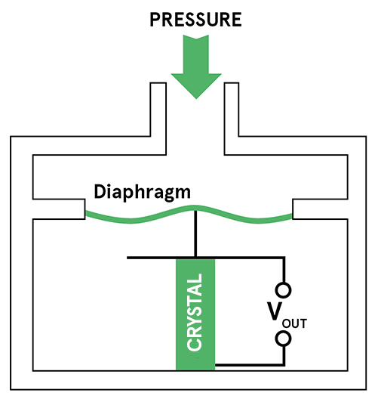
Schematic of a strain Gauge

Slide 5
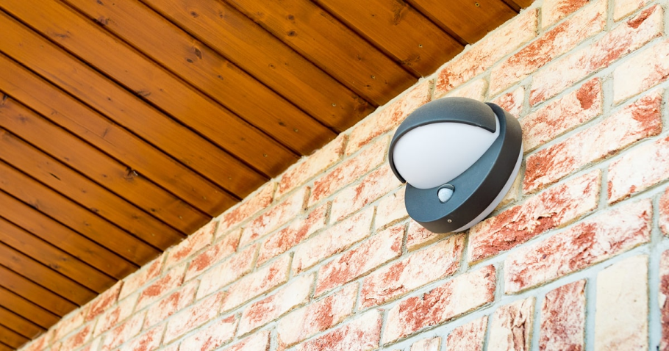
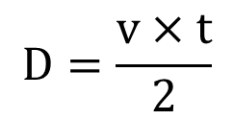
Motion Sensors
Detects movement
Based on echo sounding principle
Types of motion sensors:
Passive IR sensors
Ultrasonic sensors
Microwave sensors
Radio wave sensors
$$D=\frac{v×t}{2}$$

Slide 6
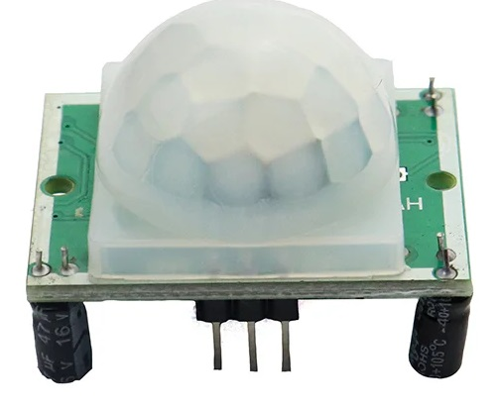
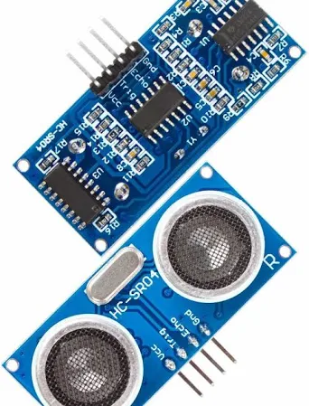
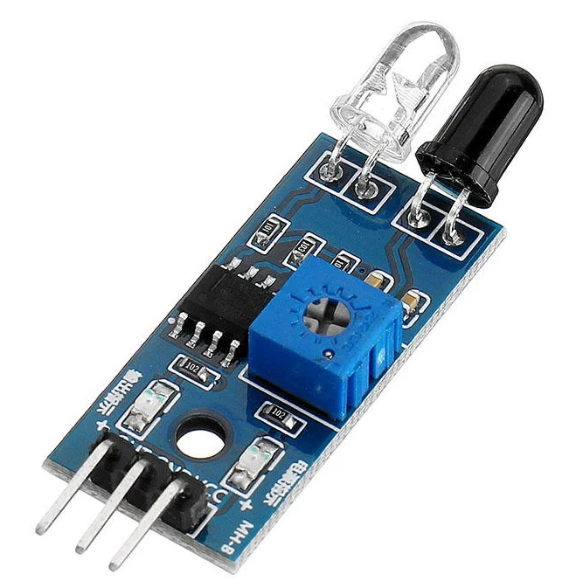
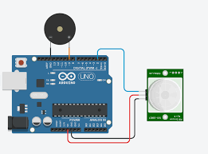
Motion Sensors for Arduino
HC-SR501
HC-SR04

Slide 7
Exercise
Determine the thickness of quartz crystal required to produce ultrasonic waves of frequency 500 kHz. Given Y = 8 x 10¹⁰ N/m² and ρ = 2650 kg/m³.
For barium titanate, Young’s modulus is 7.7 x 10¹⁰ N/m² and density is 5.5 gm/cm³. Calculate thickness of the crystal to produce ultrasonic waves of frequency 1 MHz
H.W
Find the change in thickness required if a 2 mm piece of quartz crystal is to be used for producing ultrasonic waves of frequency 2 MHz Given Y = 8 x 10¹⁰ N/m² and ρ = 2650 kg/m³.

